Slide 1




PORTABLE
PLAYABLE
LEARNABLE
A low-cost augmented reality device, targeted at rural areas with limited/no access to technology, to help children learn simple geometry and trigonometry, by interacting with shapes.

Slide 2
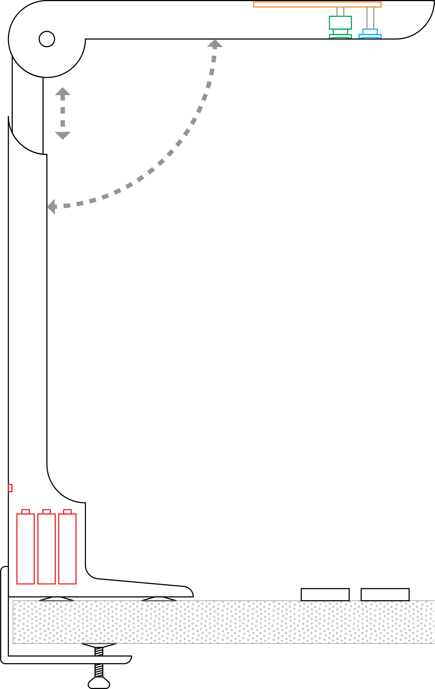
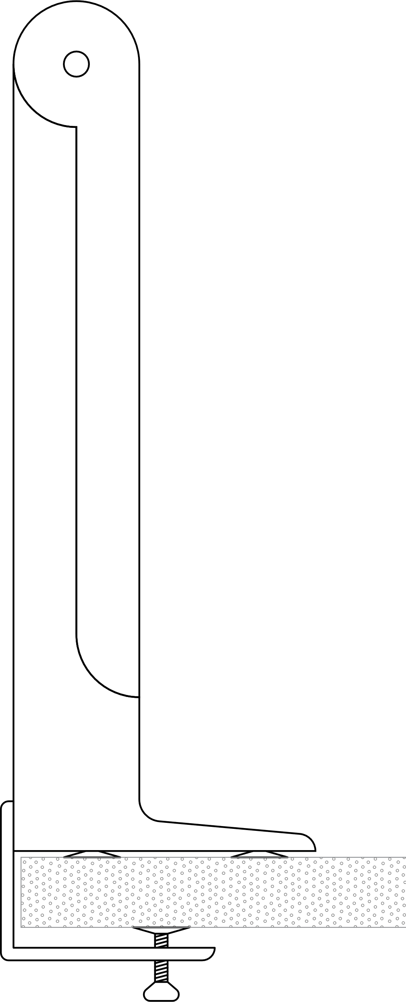
Processing Unit (Raspberry Pi)
Camera
Projector
Power Port
Rechargeable Battery
Markers
Detachable Clamp

Slide 3
PORTABLE
PLAYABLE
LEARNABLE
A low-cost augmented reality device, targeted at rural areas with limited/no access to technology, to help children learn simple geometry and trigonometry, by interacting with shapes.

